Slide 1
MM0002 MM Organization Structure - v1.0
The Organization
Goals &
Strategy
Environment
Size
Structure
Formalization
Specialization
Hierarchy of authority
Centralization
Professionalism
Personnel Ratios
Culture
Technology
Notes:
This In-house course was developed to meet the needs of SAP R/3 Consultants working at Capgemini. This course is designed to present a high level view of Materials Management Organization Structure and to provide the Consultants with basic information about how to use this Functionality.
More in-depth courses have been developed to train Consultants in specific areas discussed during this course.
Your comments at the conclusion of this training session are appreciated and will help us better tailor future courses to meet your training needs.

Slide 2
Course Objective
Become familiar with SAP Organization Levels in Procurement Process.
Definition Of Organizational units in SAP - Organization, Client, Company Code, Plant, Purchasing Organization, Storage Location, Purchasing Group.
Assignment Of Organizational units in SAP.
Creation & Assignment Of Organizational units in SAP.
Case Study & Exercise.
Tips & Tricks
Test Your Knowledge

Slide 3


Organization…?
An organization is a social arrangement which pursues collective goals, which controls its own performance, and which has a boundary separating it from its environment.
The word itself is derived from the Greek word organon meaning tool.
Notes:
An enterprise operates within a diverse environment consisting of multiple influencing factors. For example no enterprise can overlook the statutory reporting requirements to satisfy the legal authorities or afford to not respond to its customers’ needs.
Hence the need for creating specialized task force of groups of people, to deal with the external factors. This grouping of people into specialized areas, all equipped with their own systems, is called as Organization.

Slide 4





Purpose
FINANCE
PURCHASE
INVENTORY
Organization Structure
SALES
PLANNING &
PRODUCTION
SALES &
DISTRIBUTION
An organizational structure depicts the structure of an organization in terms of relationships among personnel or departments.
An organizational chart also represents lines of authority and responsibility.
An organizational chart indicates the formal structure of a business or company.

Slide 5

Use
Organization is a Group of people with specific responsibilities acting together for achieving specific purpose determined by the organization.
Any organization needs proper co-ordination within all its departments.
Link between departments is maintained in form of a hierarchy.
Organizational Structure facilitates proper flow of information, division of responsibilities & effective reporting.
A logical hierarchy is called as an Organisational Structure.

Slide 6

Challenges
Large Business houses need a specialized work force to focus on specific areas
of Business. Different units within an Organization operate in different environments and hence develop their own specialized knowledge base, procedures, tools & techniques and policies.
It is a challenge to create a hierarchical structure that will cater to the needs of individual units yet integrate the effort to meet the common objectives of the Organization as a whole.
In any Business, it becomes increasingly difficult to ensure proper coordination, proper exchange of information, ability to react quickly and collate information required to form a big picture if the organization structure is too complex or too layered.
A balanced and simple structure can optimize this need for autonomy for various units and coordinate the efforts effectively.

Slide 7
SAP Organization Unit

Slide 8
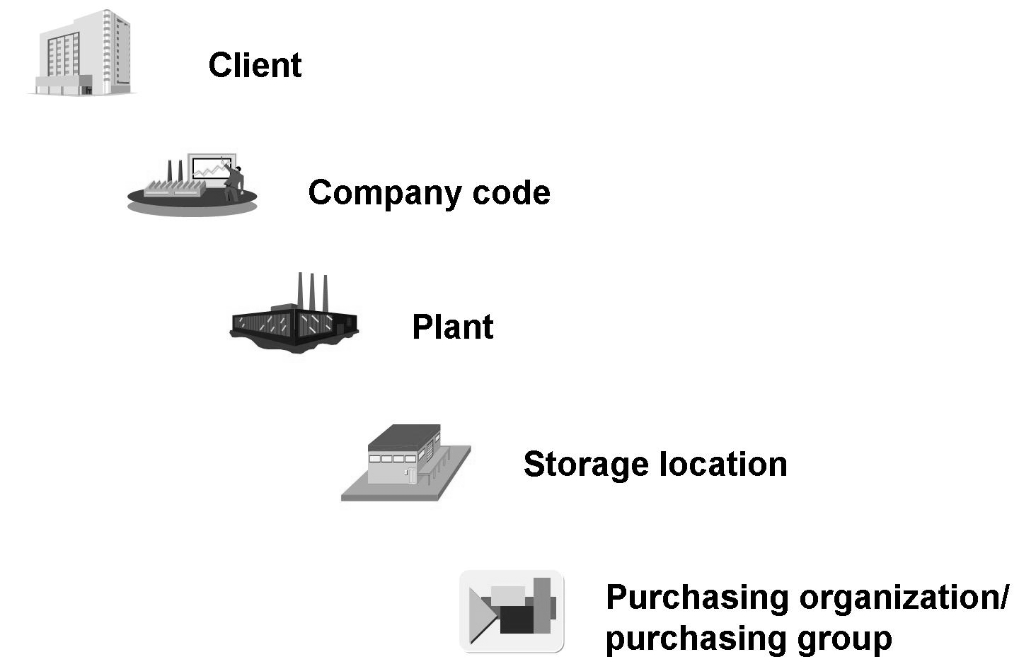
SAP Organizational Levels in Procurement Process
In the SAP system, organizational levels are structures that represent the legal or organizational views of a company.
The determination of the organizational levels is an important work step in the project. In fact, it is an essential prerequisite for all subsequent activities.
The organizational levels are defined and assigned in Customizing for the enterprise structure.
Notes:
This level contains the data applicable to all individual group companies, all plants, and all warehouses/stores belonging to an enterprise (corporate group).
Examples of material data that is valid client-wide are the material group, the short text description of a material, the storage conditions (temperature range, whether the material is explosive or perishable, and so on), and the purchase order text.

Slide 9

SAP - Organization Unit
Client
The client is a unit within an SAP system that is self-contained both in legal and organizational terms and in terms of data, with separate master records and an independent set of tables.
From a business viewpoint, the client represents a corporate group, for example.
It is the highest hierarchical level of Organizational unit, with its own data, master records and set of tables.
A client is uniquely defined in the system by a three-digit numeric key.
Examples for Client specific data:
  Application data: Business transaction data and Material Master data.
  User Master data: Authorization and User Groups .
Notes:
This level contains the data applicable to all individual group companies, all plants, and all warehouses/stores belonging to an enterprise (corporate group).
Examples of material data that is valid client-wide are the material group, the short text description of a material, the storage conditions (temperature range, whether the material is explosive or perishable, and so on), and the purchase order text.

Slide 10
The SAP Organization Structure Covers all Functional Areas…
DTS
Plant and SLOC can also be considered DTS structures
Client
Credit
Control
Area
PTP
OTC
Operating Concern
FTM
Profit Center
Controlling
Area
Storage
Location
Chart of Accounts
Cost Center
Company Code
Valuation Area
Sales Organization
Plant
Business Area
Distribution Channel
Purchasing Organization
Division
Shipping Point
Purchasing Group
Sales Office
Sales Group
Loading Point
Sales Person
© Capgemini 2017. All rights reserved |
Notes:
2.0.1_PTP_Organization Structure

Slide 11

SAP - Organization Unit
Company Code
The company code is the smallest organizational unit of external accounting for which a complete, self-contained bookkeeping system can be replicated.
This includes the entry of all events that require posting to the accounts and the creation of a complete audit trail for balance sheets and profit and loss statements. A company code represents an independent unit producing its own balance sheet, for example, a company within a corporate group (client). Therefore, a company code is the minimum structure necessary in R/3 FI.
In an international business, operations are often scattered across numerous countries. Since most government & tax authorities require the registration of a legal entity for every company, a separate Company code is usually established per country.
A company code is defined in the system by means of a four-character
alphanumeric key that is unique in the client.
Notes:
Applications:
Balance Sheet & Profit & Loss statement.
Transfers financial Information to Controlling
Material Valuation
User Level Authorization
Output Type determination

Slide 12
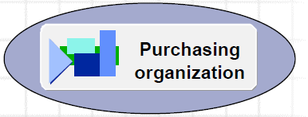
SAP - Organization Unit
Purchasing Organization
The Purchasing Organization is an organizational unit within Logistics that subdivides the enterprise according to purchasing requirements.
Procures materials or services, negotiates conditions of purchase with vendors, and assumes responsibility for these transactions.
Responsible for all types of Purchase, right from creation of RFQ to Purchase Order.
Purchasing Organization can play a role of Centralized Purchasing, Company Specific Purchasing or Plant Specific Purchasing.
Own Info records, conditions for pricing and Vendor Masters.
Negotiates conditions for purchase (price) with Vendors and with other plants.
Serves as selection criterion for list of all purchasing documents and it is the highest level of aggregation (after client) for Purchasing statistics.
Authorization to process various Purchase transaction can be controlled through Purchasing Organization
Notes:
Applications
Controls pricing conditions.
Approval of Purchase document
Output determination
Master data
User authorization

Slide 13

SAP - Organization Unit
Purchase Group
Purchasing Group is a key for a buyer or group of buyers responsible for certain
Purchasing activities.
The Purchasing group is:
  Internally responsible for the procurement of a material or a class of
  materials.
  The principal channel for a company’s dealings with its Vendors
Purchasing Group is mainly used for reporting purpose. It can be also used for controlling the approval (release strategy) of various Purchasing documents.
Purchasing group can also control the authorization for processing various purchasing transactions.
Notes:
Applications
Reporting
Output Determination
Approval of Purchase document
User authorization

Slide 14

SAP - Organization Unit
Plant
Plant is an organizational Logistics unit where certain important business functions like Production, Procurement, Inventory, Inbound & Outbound delivery processing, Plant Maintenance & Materials Planning are carried out.
Plant plays an important role in following areas
Materials can be valuated at Plant Level.
A Factory Calendar is controlled at Plant Level
Certain views like MRP, Purchasing… in the Material Master are maintained at
Plant Level.
User level authorization can be controlled at Plant Level.
A plant is defined in the system by means of a four-character alphanumeric key
that is unique in the client.
Notes:
A plant may represent a variety of entities within a firm, such as:
. Production facility
. Distribution center
. Regional sales office
. Corporate headquarters
. Maintenance location
Applications:
Material Valuation
Master data maintenance
User Level Authorization
Output Type determination

Slide 15
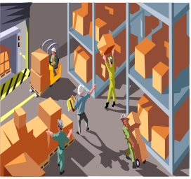
SAP - Organization Unit
Storage Location
The Storage Location is an organizational unit that allows the differentiation of material stocks within a plant.
Storage Locations are only used for informative assignment. It can be used as a parameter criteria in reporting.
Inventory is reported at storage location level. Thus at least one storage location is necessary for Inventory Management & delivery processing.
However valuation can be only at plan (or higher) level.
Storage Location has the following attributes
Physical Inventory is carried out at Storage Location level
Plant can have one or more Storage Locations
A storage location is defined by means of a four-character alphanumeric key that is unique in the plant.
Notes:
Applications
Physical Inventory
Reporting

Slide 16
Assignment of Org Units

Slide 17

Assignment of Organizational Units
In SAP R/3 you represent Organizational Structure as legal and logical representing the hierarchy of your company by assigning the organizational units which represent individual departments
This assignment forms the base for all Purchase activities in SAP, with out which no transaction can be executed
Also, it is generally necessary to interact with other organizational units such as Plants or Storage Location
Notes:
The enterprise structure is created through the assignment of organizational levels to each other.

Slide 18
Purchasing Organization
Centralized Purchasing
Plant: 4
The concept of Centralized Purchasing is used when procurement is done centrally for all the plants irrespective of there locations.
Central Purchasing helps to have a better bargaining power.
The Central Purchase org. is assigned to all the Plants and need not be assigned to there respective Company Codes.
The Plants assigned to Central Purchase Org. may or may not be assigned to another Purchasing Org.
Plant: 3
Central Purchase org: C001
Purchase
Organization
Plant: 1
Plant: 2

Slide 19
Purchasing Organization
Plant-specific Purchasing
In Plant specific Purchasing, the Purchase Org assigned to Plant is only responsible for procurement of respective Plant.
This concept is normally used to procure goods and services which are not economically viable to procure centrally.
Such Purchase org. is only assigned to the Plants and are not assigned to there respective Company codes.
The Plants assigned to such Purchase Org., may or may not be assigned to another Purchasing Org.
Purchase
Organization
Purchase
Organization
Purch Org: P001
Purch Org: P002
Plant 1000
Plant 2000

Slide 20
Purchasing Organization
Company-specific Purchasing
In Company specific Purchasing, the Purchasing Organization assigned to the Company Code is responsible for procurement of all the plants assigned to that respective Company Code.
This concept is normally used to procure goods and services which are not economically viable to procure centrally.
Such Purchasing Organizations are assigned to all the Plants and also to the respective Company Codes.
The Plants assigned to such a Purchasing Organization, may or may not be assigned to another Purchasing Organization.
Purchase
Organization
Purchase
Organization
Purch Org: P001
Purch Org: P002
Company Code: 1000
Company Code: 2000
Balance
Sheet
Balance
Sheet
Plant 1001
Plant 1002
Plant 2001
Plant 2002

Slide 21
Purchasing Organization
Reference Purchase Organization
Vendor: ABC
P Org: R001
Contract
Vendor Master
Vendor: ABC
P Org: R001
Material: 1000
Qty: 10000
Reference
P Org: R001
Material: 1000
Vendor: ABC
P Org: R001
Purch. Info
Purchase Order
Vendor: ABC
P Org: P001
Material: 1000
Purchase
Organization
Purch Org: P001

Slide 22
Purchasing Organization
Reference Purchasing Organization
Reference Purchasing Organization is like a Central Purchasing Organization whose conditions or contracts, other Purchasing Organizations (linked to it) can use to procure materials & services.
Reference Purchasing Organization gives a better bargaining power to other Purchasing Organizations (linked to it) as it is in a better position to negotiate a comprehensive Contract with favorable conditions.
It also saves time and effort in maintaining master data. The Vendor Master and Purchasing Info Record created with Ref. Purchasing Organization can be used by other Purchasing Organizations linked to it.
A Reference Purchasing Organization need not be assigned to any Company Code or Plant.

Slide 23
Purchasing Organization
Standard Purchasing Organization
Standard
P Org: P003
Purch Org
P001
Purch Org
P002
Plant: 1
Standard Purchasing Organization is used in Pipeline procurement, Consignment and Stock
Transfer process.
This helps when a single plant is assigned to many Purchasing Organization. In such a scenario one
of the Purchasing Organization can be defined as Standard Purchasing Organization.
In case of Consignment and Stock transfer process, system does the source
determination automatically with the help of Standard Purchase Org.
In case of Pipeline procurement Info record created for Standard Purchasing Org is used for issue of
Material.

Slide 24
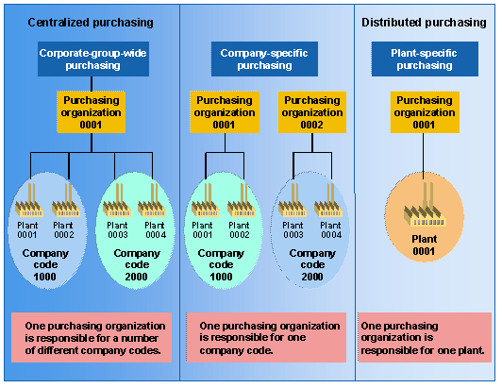
Purchase Organization Assignment Overview

Slide 25
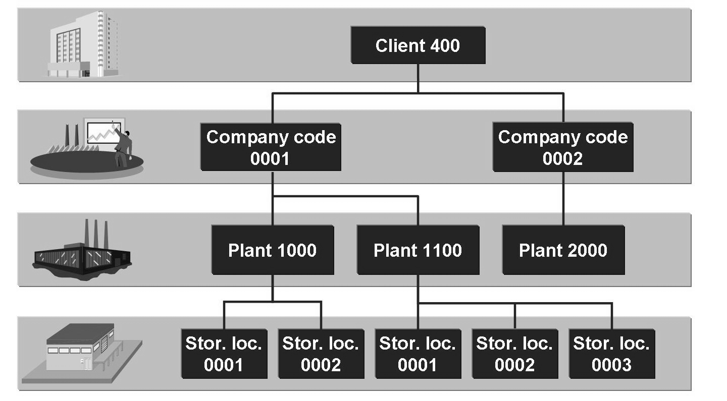
Assignment of Organizational units in Inventory Management
The enterprise structure is created through the assignment of organizational levels to each other.
A Client may therefore contain several Company Codes. In turn, a Company Code may contain several Plants.
A Plant can only ever belong to one Company Code.

Slide 26
Organization for Inventory Management
Plants are assigned to the Company Code. More than one Plant can be assigned to one Company Code. A Plant cannot be assigned to multiple Company Codes.
Storage Locations are assigned to a Plant. Multiple Storage Locations can be assigned to a Plant.
It is always recommended to create a new Company Code, Plant and Storage Location by copying it with reference to standard organization unit.
Since the key of a Plant is unique in a Client, and a Plant can only belong to one Company Code, by specifying the plant, you simultaneously specify the Company Code.

Slide 27
MM0002 MM Organization Struct.
Prepare Me
1
2
TellMe
3
Show Me
4
Let Me
5
Help Me

Slide 28
Agenda
Defining of Org Unit
Assignment of Org Unit

Slide 29
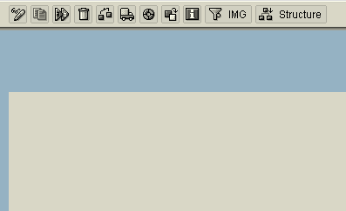
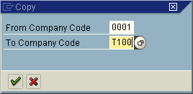
Define – Company Code
It is a 2 step procedure to create a Company Code
STEP 1
SPRO → Enterprise Structure → Definition → Financial Accounting → Edit, Copy,
Delete, Check Company Code → Copy, delete, check company code
a
b
Press the icon to create a new Company
code with reference to an existing Comp Code.
c
In the Tab “From”
enter the Comp code
which is used as reference & in Tab “To” enter the new Comp code to be created
Notes:
You can also directly access the Screen of creation of Company Code through T Code: OX02
When a Company Code is created by copying a reference Company code, system copies all the details like the Name, City, Country code, Currency and Language from the Reference Company Code used.
You need to change the details (if required) which is explained in the next slide STEP 2.
While creating a company code with reference, system prompts whether to create all the G&L accounts of reference company code. It also prompts whether to change the Currency code copied from the reference company code.

Slide 30
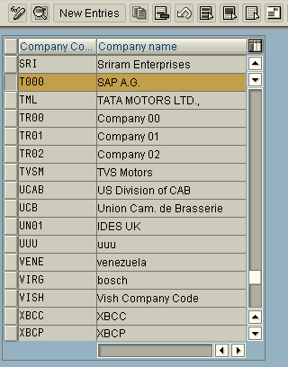
Define – Company Code
STEP 2
SPRO → Enterprise Structure → Definition → Financial Accounting → Edit, Copy,
Delete, Check Company Code → Edit company code data
a
b
Select the Comp Code created and press icon or via Ctrl + Shift + F2 to view the Comp Code details.
You can also view the details the menu path Goto → Details
Comp Code can be created directly from this
option, but it is not recommended since there are
613 Tables that needs to be updated for the Comp
code to function. These tables are not updated
fully if the Comp Code is not created with
reference to an existing Comp Code.
Contd…..
Notes:
You can also directly access the Screen of Edit Company code through T Code: OX02

Slide 31
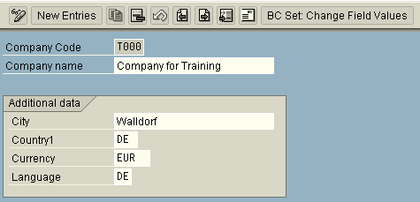
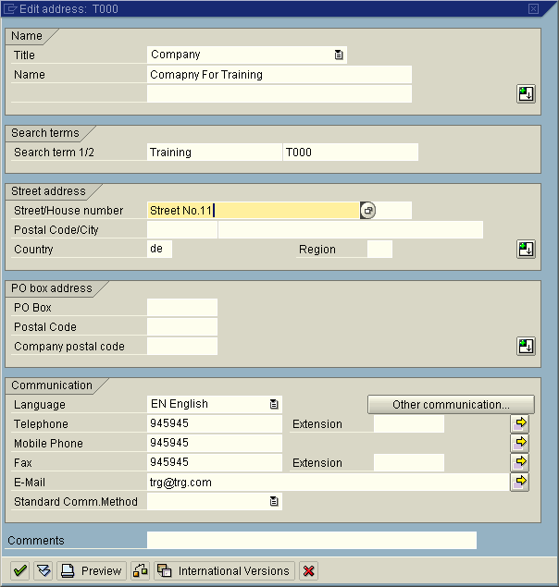
Define – Company Code
d
Press icon to access the address details Tab.
c
Press icon to view all the fields
of address screen.

Slide 32
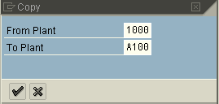
Define – Plant
It is a 2 step procedure to create a Plant
STEP 1
SPRO → Enterprise Structure → Definition → Logistics General → Define, copy, delete
check plant → Copy, delete, check plant
a
b
Press the icon to create a new Plant with
Reference to an existing Plant.
c
In the Tab “From”
enter the Plant code
which is used as reference & in Tab “To” enter the new Plant code to be created
Notes:
When a Plant is created by copying a reference plant, system copies all the details like the Name, Address & Factory Calendar from the Reference Plant used.
You need to change the details (if required) which is explained in the next slide STEP 2.

Slide 33
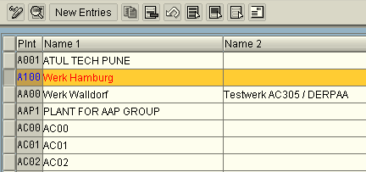
Define – Plant
STEP 2
SPRO → Enterprise Structure → Definition → Logistics General → Define, copy, delete
check plant → Define Plant
a
b
Select the Plant created and press icon or via Ctrl + Shift + F2 to view the Plant details.
You can also view the details the menu path Goto → Details
Plant can be created directly from the option “Define Plant”, but it is not recommended,
since there are 251 Tables which needs to be updated for the Plant to function. These
Tables are not updated fully if the Plant is and not created with reference to an
existing Plant.
Contd…..
Notes:
You can also directly access the Screen of Copy, delete check plant through T Code: OX10

Slide 34
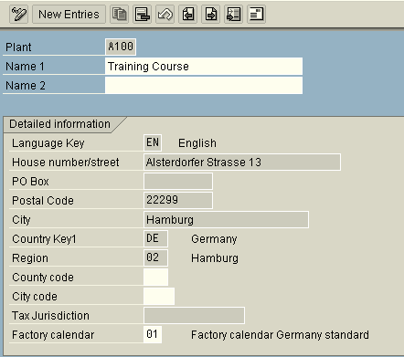
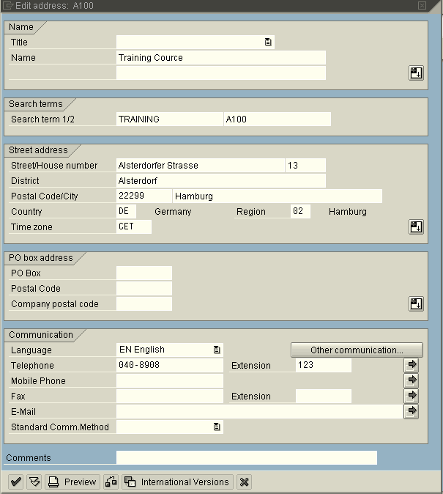
Define – Plant
c
d
Press icon to access the address details Tab.
Press icon to view all the fields
of address screen.
Notes:
Factory Calendar code, assigned to the Plant decides the total number of working days and also the public holidays applicable to the Plant. The information is later used by various departments. Example: during MRP run while calculating the processing time it takes into consideration the public holidays as per the Factory Calendar code assigned to the Plant.
Tax Code and Export business are determined by the Country Code maintained in the Plant Code.

Slide 35
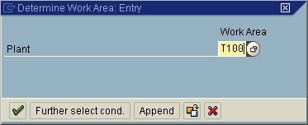

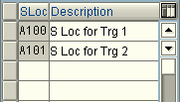

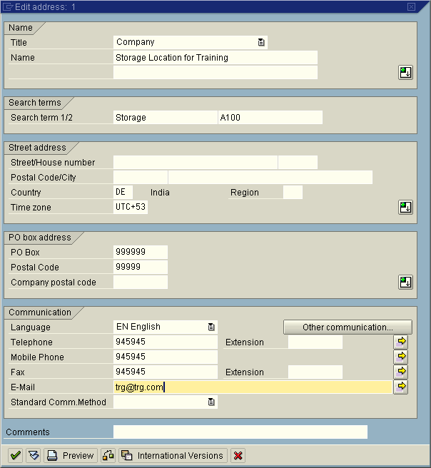


Define – Storage Location
SPRO → Enterprise Structure → Definition → Materials Management → Maintain
Storage Location
2
1
Click
to create a new
Storage Location
3
You can maintain multiple addresses to a same Storage location through Sequential Storage location number
Click to
get the address
tab.
Notes:
You can also directly access the Transaction through T Code: OX09
Storage location are always created for a plant. You may or may not maintain Address to the Storage Location.
For creating storage location, the minimum fields that needs to be updated are Plant code and Storage location code.
In Address Tab, Postal Code and Country are minimum fields which needs to be updated.

Slide 36
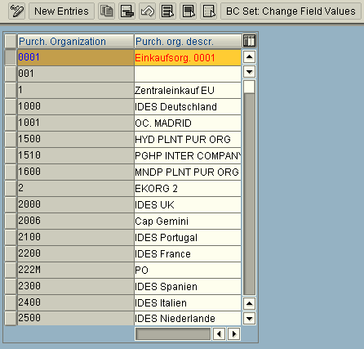

Define – Purchasing Organization
SPRO → Enterprise Structure → Definition → Materials Management → Maintain
Purchase Organization
Press icon to create a new Purchase Organization.
Press icon to create a new Purch Organization with reference to a existing Purchase organization.
Notes:
You can also access the transaction through Trans Code: OX08
Purchasing Organization code can be 4 digits alpha numeric. You can only maintain maximum of 20 characters Purchase org description.

Slide 37
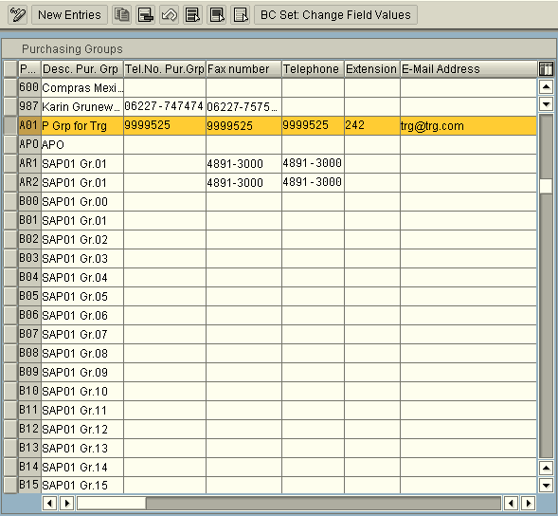
Define – Purchasing Group
SPRO → Materials Management → Purchasing → Create Purchasing Groups
Press icon to create a new Purchasing Group.
Press icon to create a new Purch Group with reference to a existing Purchase Group.
Notes:
You can also access the transaction through Trans Code: OME4
Purchasing Group code can be 3 digits alpha numeric. Purchasing Group is an hanging entity. It is not assigned to any of the Organization unit.
The data maintained against Purchasing Group code are used for reporting purpose.

Slide 38
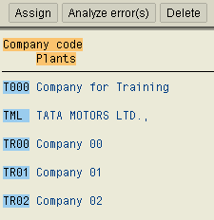
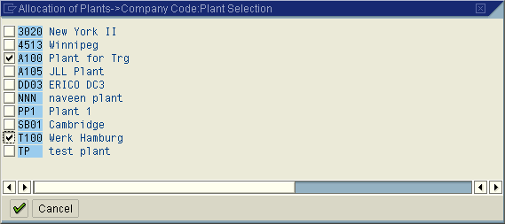
Assignment – Plant to Company Code
SPRO → Enterprise Structure → Assignment → Logistics General → Assign Plant
to Company code
Select the Comp code
and press tab
to a assign Plant
System display all the Unassigned Plant Codes.
Select the relevant Plant Code and save the
transaction.
Notes:
You can also access the transaction through Trans Code: OX18
If a Plant code is created with reference to existing a Plant code, then by default the new plant is assigned to the company code to which the reference Plant code is assigned. To remove the assignment, select the new plant code and press “Delete” icon.
Company Code and Plant Code has one to many relationship. A Plant can be only assigned to one company code.
There is also an option to analyse the errors in detail if any through icon “Analyze”.

Slide 39
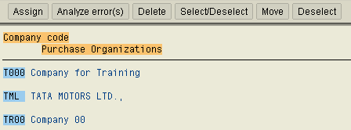
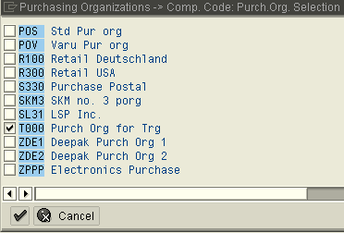
Assignment – Purch org to Comp Code
SPRO → Enterprise Structure → Assignment → Materials Management → Assign
Purchasing Organization to Company code
Select the Comp code
and press tab
to a assign Purchasing org
System display all the Unassigned Purchase Organization.
Select the relevant Purch Org and save the transaction.
Notes:
You can also access the transaction through Trans Code: OX01
Company Code and Purchase Org has one to many relationship. One Purchase Org can be assigned to only one Company Code
You can change the assignments by moving the Purchase organization from one company code to another by using the icon “Move”.
Incase of Central Purchase, the Purchase Org need not be assigned to the Company Code.
Incase of Plant Specific Purchase, Purchase org should not be assigned to the Company Code.

Slide 40
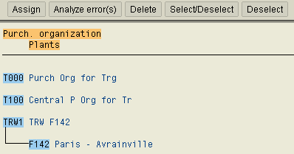
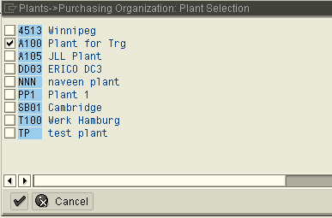
Assignment – Purch org to Plant
SPRO → Enterprise Structure → Assignment → Materials Management → Assign
Purchasing Organization to Plant
Select the Purchasing Org
and press tab
to a assign Plant.
System display all the Plant
Select the relevant Plant and save the transaction.
Notes:
You can also access the transaction through Trans Code: OX17
Purchase Org and Plant have one to many relationship. A Plant can be assigned to multiple Purchasing Org.
You can also have a details analyzes on the errors (if any) through icon “Analyze”.
For Central Purchasing, Purchase org has to be assigned to all the Plants.
For Plant Specific purchasing, Purchase org has to be assigned to the concerned Plant.

Slide 41
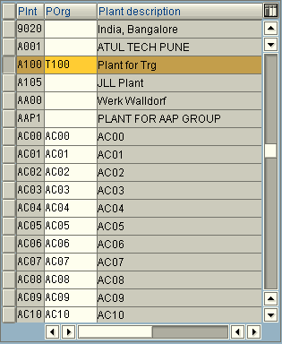
Assignment – Standard Purchasing Org - Plant
SPRO → Enterprise Structure → Assignment → Materials Management → Assign
Standard purchasing organization to plant
From the Purchase Organizations assigned to a
Plant, one Purchase org can be assigned as a
Standard Purchase Organization.
One Purchase Organization can be assigned to
Multiple Plants as a Standard Purchase Org.
Notes:
You can also access the transaction through Trans Code: OMKI

Slide 42
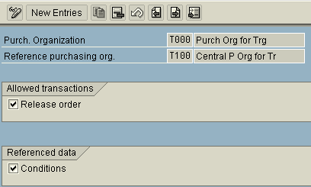
Assignment – Purchase org - Ref Purch org
SPRO → Enterprise Structure → Assignment → Materials Management → Assign
Purchasing Organization to reference Purchasing Organization
One Reference Purchase Organization can be assigned to multiple Purchasing Organization.
Select “Release Order” if you want to allow release orders against Contract
set up by the Reference Purchase Org.
Select “Conditions” if you want to use conditions maintained for the Reference Purchase Org.

Slide 43
MM0002 MM Organization Struct.
Prepare Me
1
2
TellMe
3
Show Me
4
Let Me
5
Help Me

Slide 44
Case Study
ABC Corporation has business setup in Germany and India with its head quarters
based in Frankfurt.
In Germany it has 2 manufacturing plants, one located in Darmstadt and the other in
Hamburg. Each manufacturing plant handles only 2 type of materials, stocked in
distinct locations. ABC Corporation also has one depot located in Darmstadt from
where it supplies material to its Whole sellers.
In India, ABC Corporation has 1 manufacturing plant located in Gujarat and 1 depot
in Mumbai. Manufacturing Plant handles only 2 type of materials, stocked in distinct
locations.
There is a Purchasing department located in head quarter who centrally procures
materials for all the plants located in Germany and India.

Slide 45
Case Study
There are also separate purchasing department located in India & Germany who is
responsible for plant specific procurement.
The strength of the each purchasing department is 2 employee, who are responsible
to negotiate and deal with Vendors.
You need to map the organization structure of ABC Corporation in SAP

Slide 46
Exercise
Create 2 Company Codes each for India and Germany
Create 3 Plants codes (2 manufacturing unit and 1 Depot) and assign to the company code created for Germany.
Create 2 Plants codes (1 manufacturing unit and 1 Depot) and assign to the company code created for India.
Create 8 Storage Locations. 2 each for manufacturing plants and 1 each for the Depots.
Create Central Purchasing Org and assign to all the manufacturing plant located in India and Germany.
Create 2 Purchasing Org and assign each to respective plants located in India and Germany.
Create 6 Purchasing groups (2 for each Purchasing Org).

Slide 47
MM0002 MM Organization Structure
1
Prepare Me
2
TellMe
3
Show Me
4
Let Me
5
Help Me

Slide 48
Tips and Tricks
Transaction Code can be viewed in SPRO by using the following path
Display IMG(SPRO)→ Additional Information→ Additional
Information → Display Key→ IMG Activity.
From the main menu select Additional information → Display key → Attributes.
The last 4 characters of attributes forms the Trans code.
You can display the Total tables affected by company code in the company code creation screen from main menu Extras → Associated Tables.
You can also display the tables affected by Plant code in the plant code creation screen from main menu Extras → Associated Tables.
You can use the F1 field help (icon on screen or function key F1 on keyboard) to display possible entries for this field.
By pressing the F4 key, you get information on possible input values. Alternately, you can click the pushbutton directly to the right of a selected field to invoke the input help for that field.

Slide 49
Additional Information
The definition of organization units is a fundamental step in your project. It is a critical factor in how the project will be structured. You should not use more organization units than necessary. Once you have decided on an organizational structure it is not easy to change it.
In order to simplify master record and document entry, the organizational units can be stored as user parameters in the user master record. It is not necessary to specify the organizational units since the values are proposed automatically.
The following are examples of IDs defined for user parameters:
  WRK – Plant
  EKO – Purchase Organization
  EKG – Purchase Group

Slide 50
Test Your Knowledge
1. Which statements apply to a client in an SAP system?
Choose the correct answer(s).
□ A A Client forms a completely independent business unit.
□ B A Client has its own database.
□ C A Client corresponds with a customer.
□ D A Client can represent an entire company.
2. You can use the F1 key to ...
Choose the correct answer(s).
□ A Obtain an explanation of the meaning/significance of a field
□ B View a list of possible entries
□ C Change your user data (such as the logon language)
□ D Exit the current session
□ E Obtain technical details relating to a field

Slide 51
Test Your Knowledge
3. You use the F4 key to ...
Choose the correct answer(s).
□ A Open a new session
□ B Obtain technical details relating to a program
□ C Call up the SAP Library
□ D Obtain a list of possible entries for an input field
□ E Generate a print request for the current screen
4. A Plant can be assigned to several Company Codes.
Determine whether this statement is true or false.
□ True
□ False

Slide 52
Test Your Knowledge
5. A Purchasing Organization can act for several Plants.
Determine whether this statement is true or false.
□ True
□ False
6. A Purchasing Group must always be assigned to a Purchasing Organization.
Determine whether this statement is true or false.
□ True
□ False
7. A Purchasing Organization must always be assigned to a Company Code.
Determine whether this statement is true or false.
□ True
□ False

Slide 53
Answers

